Slide 1


ASYNCHRONOUS SEQUENTIAL CIRCUITS & MEMORY DEVICES
UNIT-5

Slide 2
Unit Outcome
Need of the Asynchronous Sequential circuit and its design procedure
Compare the Critical and Non-critical races and methods to overcome critical races
Knowledge about memory devices

Slide 3
SEQUENTIAL LOGIC
Sequential logic is a type of logic circuit whose output depends not only on the present value of its input signals but on the sequence of past inputs, the input history as well

Slide 4
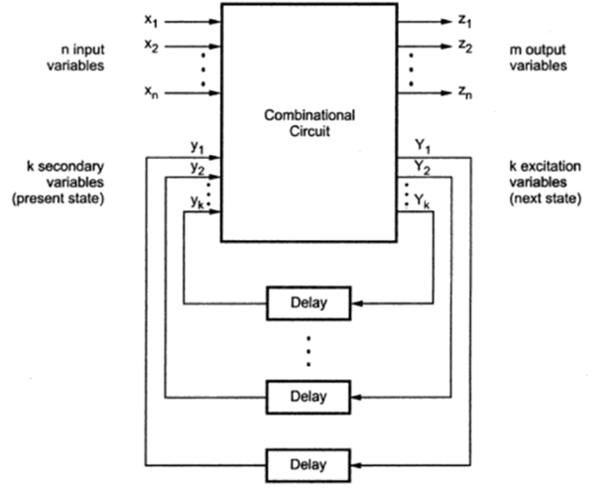
Asynchronous sequential circuits:
Asynchronous sequential circuits  Internal states can change at any instant of time when there is a change in the input variables  No clock signal is required  Have better performance but hard to design due to timing problems

Slide 5
Types of Asynchronous Circuits
Fundamental mode
The input variables change only when the circuit is stable
Only one input variables can changes at a time
Inputs are levels not pulses
Pulse mode
Inputs variables are pulses not levels
The width of the pulse is long enough for the circuit to respond to the input

Slide 6
DESIGN PROCEDURE
Step-1: Draw state diagram
Step-2:Primitive flow table
Step-3:Reduction of primitive flow table
Step-4:State assignment
Step-5:Realization

Slide 7
Design a asynchronous sequential circuit with two inputs X and Y and output Z. Whenever Y is 1, input X is transferred to Z. When Y is 0, the output does not change for any change in X
Inputs---- X & Y
Output---- Z
Condition:
- | 1 | X
- | 0 | Doesnot Change
X
Y
Z

Slide 8
Transition State
00
X
Y
01
10
11

Slide 9
STATE DIAGRAM
00
A-00
A
00
00
0
B-01
01
10
01
B
C-10
C
0
01
0
11
01
11
10
D-11
11
D
E-01
1
10
00
F
1
F-00
E
00
1
11
10
01

Slide 10
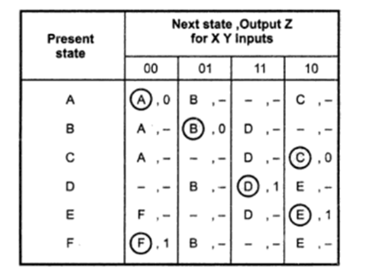
Primitive Flow Table

Slide 11
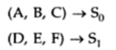
Merger Graph
A,B,C OUTPUT=0
A
B
F
D,E,F OUTPUT=1
E
C
D

Slide 12
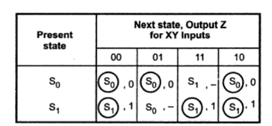
Reduced Flow Table
From the Primitive Flow table substitute instead of present state

Slide 13
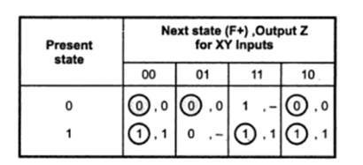
Transition Table
From the Reduced Flow table substitute instead of present state
0
1

Slide 14
Implementation
Traditional Method
Implementation using SR Latch

Slide 15
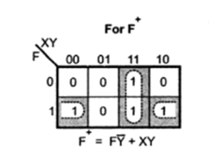
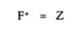
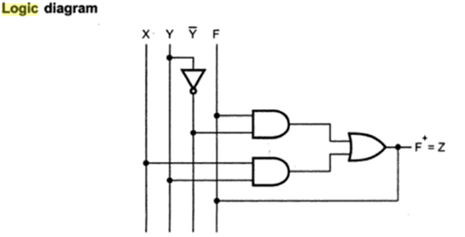
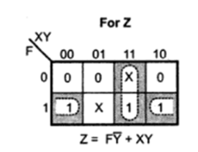
Traditional Method
K-map Simplification
Next state
Output

Slide 16
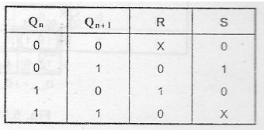
Implementation using SR Latch
Input | F | F⁺ | S | R
00 | 0 | 0 | 0 | X
01 | 0 | 0 | 0 | X
11 | 0 | 1 | 1 | 0
10 | 0 | 0 | 0 | X
00 | 1 | 1 | X | 0
01 | 1 | 0 | 0 | 1
11 | 1 | 1 | X | 0
10 | 1 | 1 | X | 0
Excitation Table

Slide 17
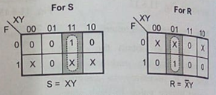
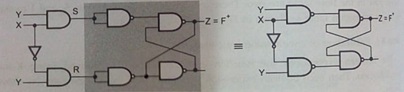
Implementation using SR Latch
K-map Simplification
Logic Diagram

Slide 18
Race Condition
When two or more binary state variable change their value in response to a change in a input variable ,race condition occur in an asynchronous sequential circuit.
In case of unequal delays, a race condition may cause the state variable to change in an unpredictable manner.
Example: IF 00------11 then the race condition occur when 00-----01------11 or 00-------10-------11

Slide 19
Critical and Non-Critical Races
If the final stable state that the circuit reaches doesnot depend on the order in which the state variable changes ,the race condition is not harmful and it is called a non-critical races
If the final stable state depends on the order in which the state variable changes ,the race condition is harmful and it is called a critical races

Slide 20
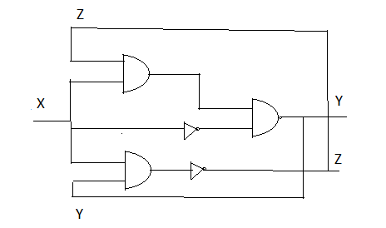
Propagation Delay
Example
0.5 ns
Total delay for Y=0.5ns
Total delay for Z=1 ns
0.5 ns
0.5 ns
Propagation delay is the length of time taken for the quantity of interest to reach its destination.

Slide 21
Example:
STABLE
X
1
YZ
0
Assume
X=0 (INPUT), YZ=00(PRESENT STATE)
(since input is 0 there is no change in next state)
X=1 (INPUT), YZ=00(PRESENT STATE), YZ=11(NEXT STATE)
00 11
00 01 11
00 10 11
00 | 11
 | 10
 | 11
 | 01
00
01
11
NON-CRITICAL RACES
10
STABLE

Slide 22
Example:
X
1
YZ
0
Assume
X=0 (INPUT), YZ=00(PRESENT STATE)
(since input is 0 there is no change in next state)
X=1 (INPUT), YZ=00(PRESENT STATE), YZ=11(NEXT STATE)
00 11
00 01
00 10
00 | 11
 | 10
 | 11
 | 01
00
01
11
CRITICAL RACES
10
STABLE
Due to change in Propagation delay

Slide 23
Cycles: It occurs when an asynchronous circuit makes a transition through a series of unstable states
Techniques commonly used for making a critical-race free state assignment
Shared row state assignment
One hot state assignment or Multiple row method

Slide 24
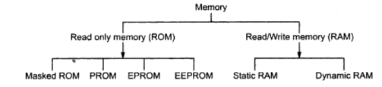
Memory Devices
A memory is just like a human brain. It is used to store data and instruction. Computer memory is the storage space in computer where data is to be processed and instructions required for processing are stored.
Classification of Memories

Slide 25
RAM-Random Access Memory
A RAM constitutes the internal memory of the CPU for storing data, program and program result. It is read/write memory. It is called random access memory (RAM).It is called Volatile Memory
Static RAM- Capable of retaining their state as long as power is applied.
Dynamic RAM -unlike SRAM, must be continually refreshed in order for it to maintain the data.

Slide 26
ROM-Read Only Memory
ROM stands for Read Only Memory. The memory from which we can only read but cannot write on it. This type of memory is non-volatile.
MROM (Masked ROM)-The very first ROMs were hard-wired devices that contained a pre-programmed set of data or instructions. These kind of ROMs are known as masked ROMs. It is inexpensive ROM.
PROM (Programmable Read Only Memory)-PROM is read-only memory that can be modified only once by a user. It can be programmed only once and is not erasable.
EPROM (Erasable and Programmable Read Only Memory)-The EPROM can be erased by exposing it to ultra-violet light for a duration of upto 40 minutes
EEPROM (Electrically Erasable and Programmable Read Only Memory)-The EEPROM is programmed and erased electrically. It can be erased and reprogrammed about ten thousand times. Both erasing and programming take about 4 to 10 ms (millisecond). In EEPROM, any location can be selectively erased and programmed. EEPROMs can be erased one byte at a time, rather than erasing the entire chip. Hence, the process of re-programming is flexible but slow.

Slide 27
Thank You

